Slide 1

Detecting Breast Cancer from Mammogram Images Using a CNN
CIND-860:
Advanced Data Analytics Project
Robert M. Pineau
941-049-371
Supervisor: Dr. Ceni Babaoglu
April 3rd, 2024

Slide 2

Why Breast Cancer? Wife: Lucy Daughter: Emma Daughter: Alyssa

Slide 3
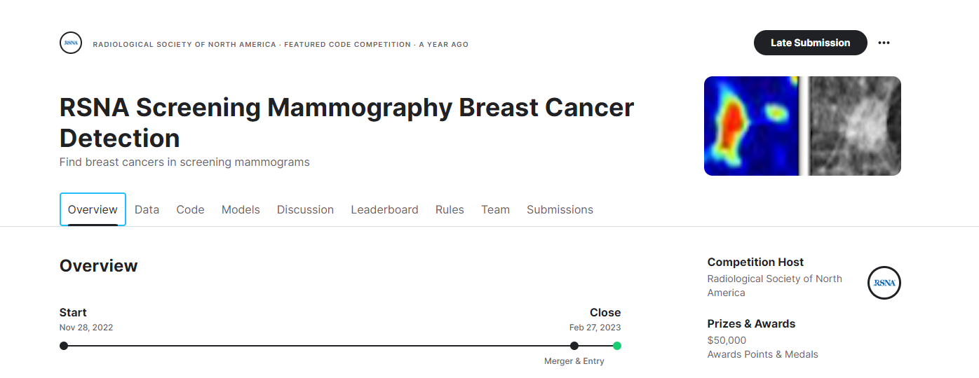
The Data: https://www.kaggle.com/competitions/rsna-breast-cancer-detection/data

Slide 4
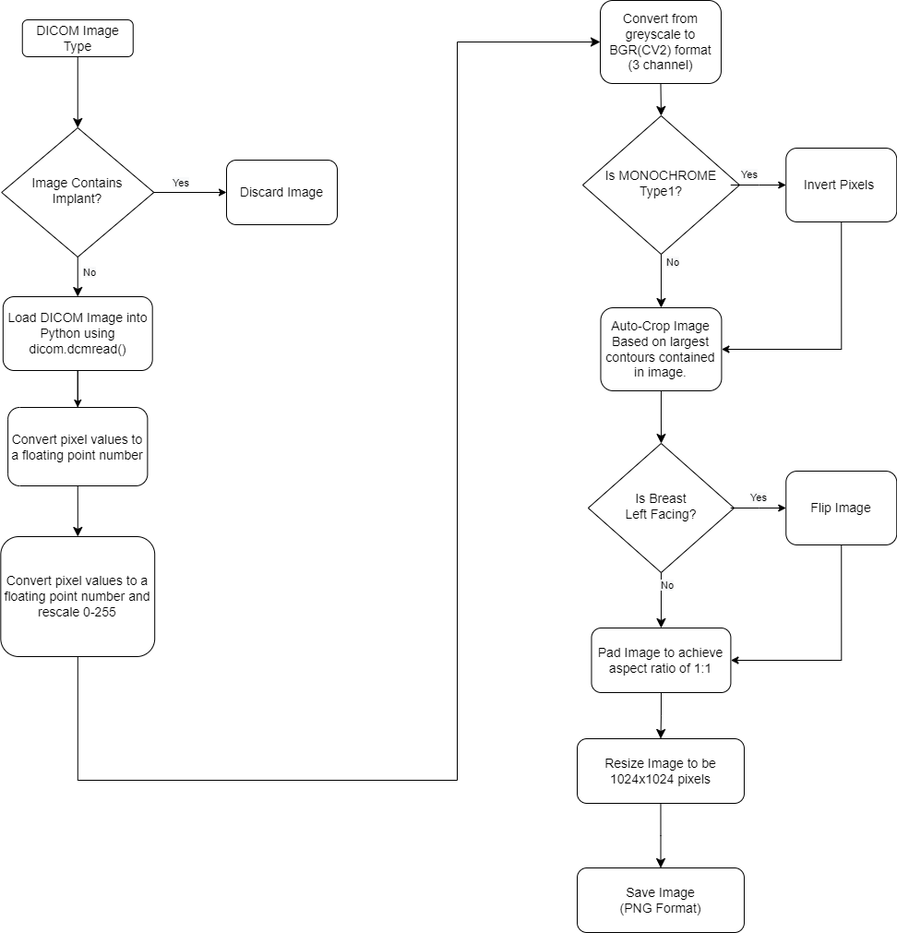
Data Preparation:

Slide 5
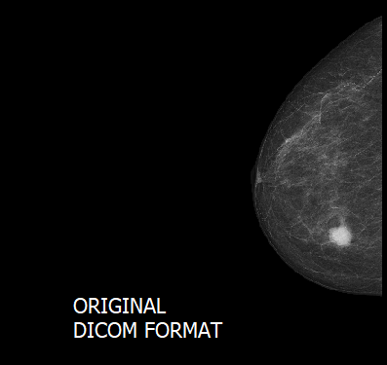
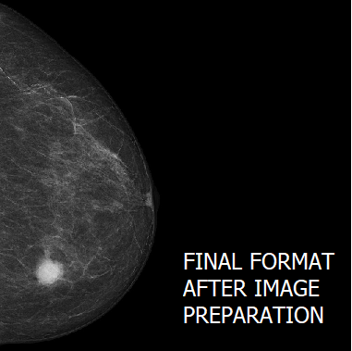
Data Preparation: Example

Slide 6
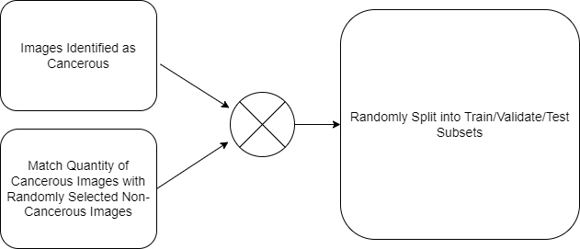
Split Image Database into Balanced Train, Validate, and Test Subsets
1145
2290
1145
TRAIN: 60% 1374
VALIDATE: 20% 458
TEST: 20% 458

Slide 7
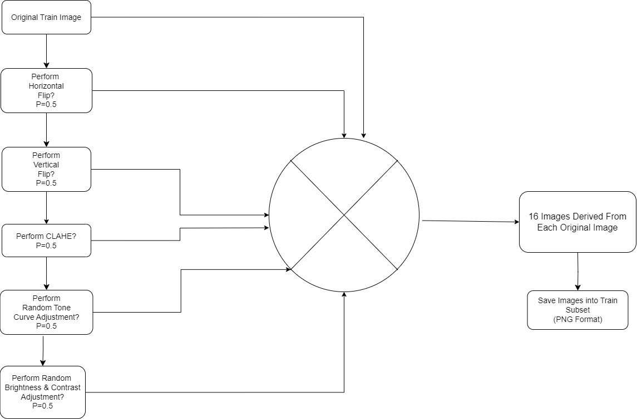
Training Data Augmentation:

Slide 8
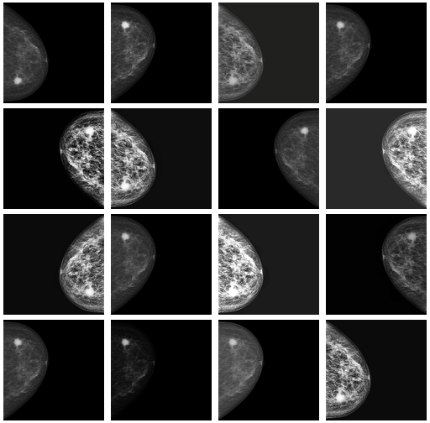
Training Data Augmentation: Example

Slide 9
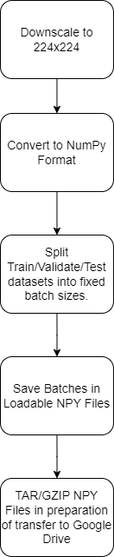
Final Data Encapsulation For ML Training, Validation, and Testing.

Slide 10
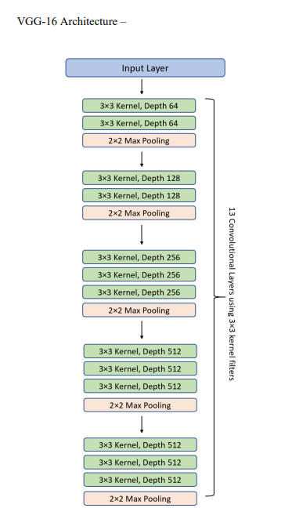
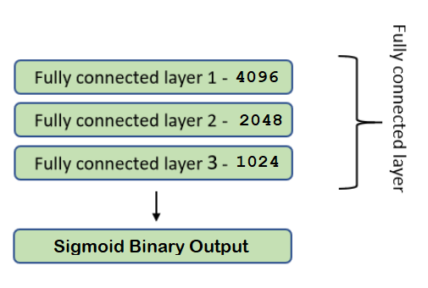
CNN Model #1
VGG16
Image From “Transfer learning using VGG-16 with Deep Convolutional Neural Network for Classifying Images” Srikanth Tammina, 2019

Slide 11
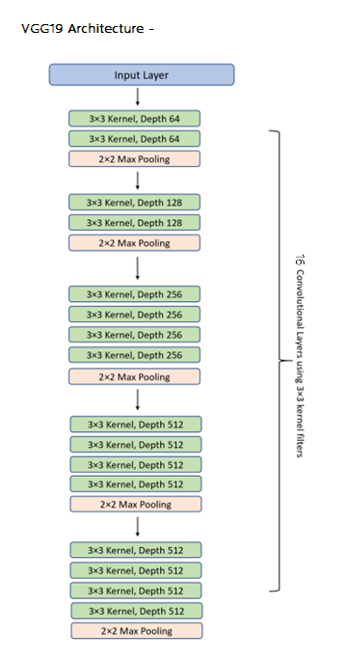
CNN Model #2
VGG19
Image based on “Transfer learning using VGG-16 with Deep Convolutional Neural Network for Classifying Images” Srikanth Tammina, 2019

Slide 12
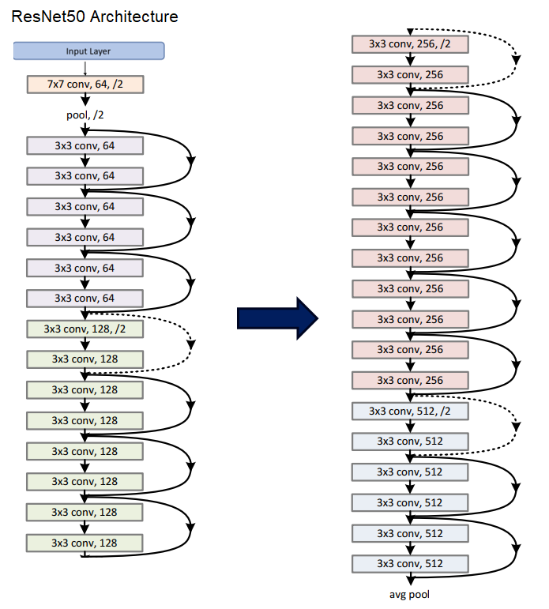
CNN Model #3
ResNet50
Image From “Deep Residual Learning for Image Recognition” He, Zhang, Ren, et Al.

Slide 13
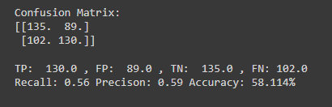
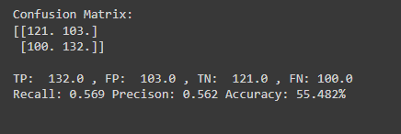
Results? (Not Good)
VGG19:
ResNet50:

Slide 14
Next-Steps:
Further Clean-up the data?
Explore alternative data-augmentation types?
Explore a model that takes in 4 images L-CC, R-CC, L-MLO, R-MLO?

Slide 15
Questions?

